Slide 1

Shri Vaishnav Vidyapeeth Vishwavidyalaya
Under the guidance of
Mr. Shubham Kothari
Submitted by(team)
Aakash Jain (18100BTCSAII02825)
Aman Rao Sanas (18100BTCSAII02830)
Chinmay Jain (18100BTCSAII02837)

Slide 2

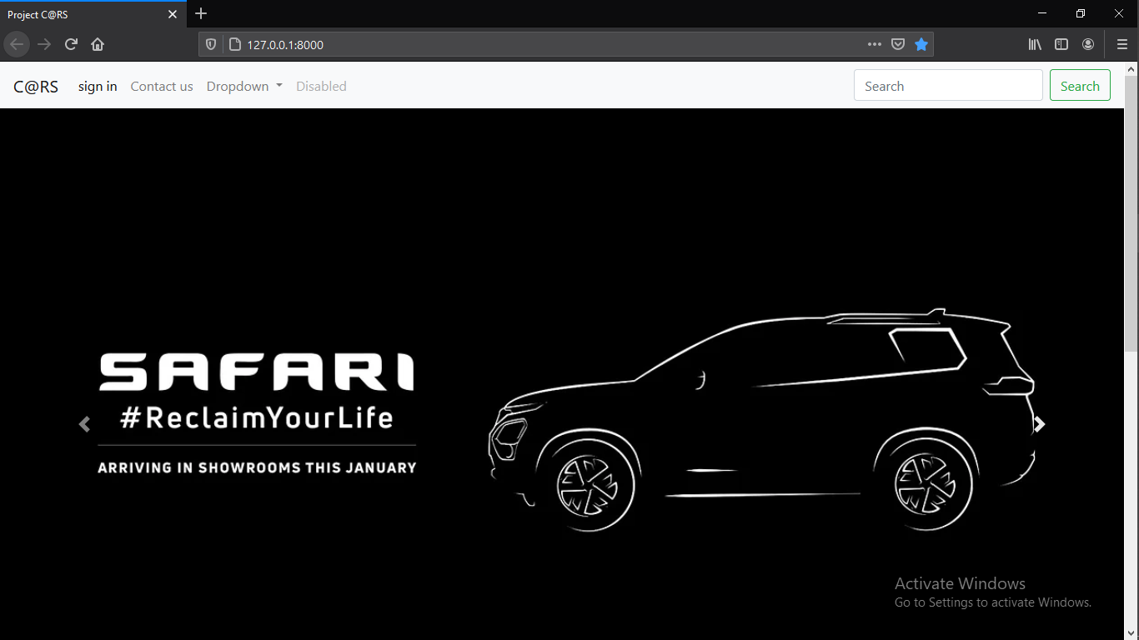

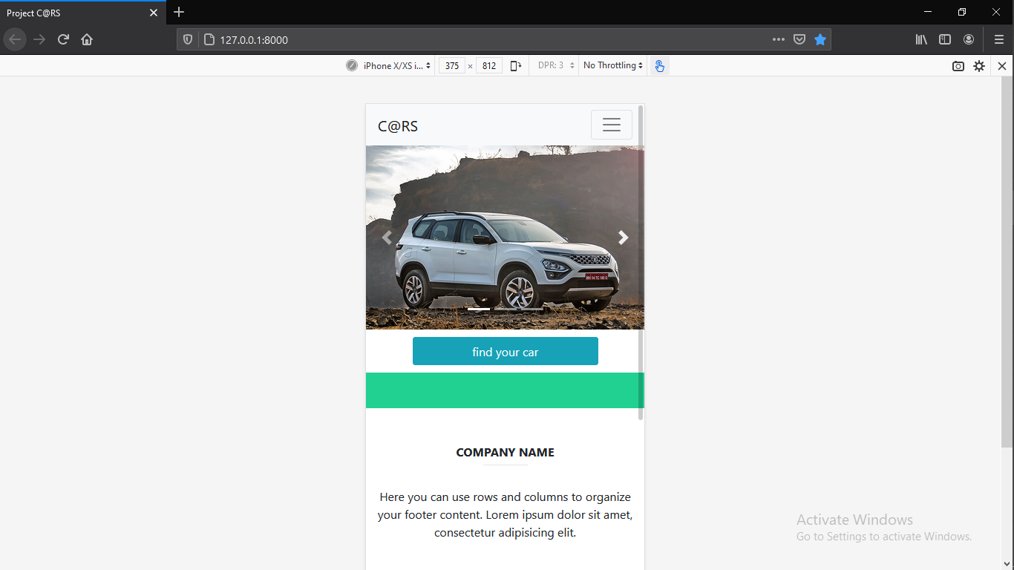
C@RS.
Invest your money wisely

Slide 3
Outline
Introduction
Abstract
Problem statement
Literature review
System Requirement
Technology used
Methodology
UML diagrams
Conclusion
Limitations of project
Future enhancement
Reference
Screenshots

Slide 4
Introduction

Slide 5
Introduction
Buying a new car is a matter of headache for those people who do not have any personal knowledge about automobile sector. And when they going to buy a new car they faced many problem regarding car information in this situations they feel the necessity of a automobile knowledge to sort out the problems. So if it is possible to design or develop a web based application for availing knowledge regarding car and automobile sector whenever and wherever possible, then it will be beneficial for both customer as well as sellers.

Slide 6
Contd.
Now a days, by some clicks only, we can get whatever you want at home.We already know about the online shopping, e-banking etc. Similarly, The Cars is the online car review website in which within few clicks only we get access or get full knowledge about car including images and featured . Some people can not have a car, for those people this system becomes very helpful. This system includes various cars information , as per the customer review and comfort.

Slide 7
Abstract

Slide 8
Abstract
Our system is designed for such users/buyers who are interested in purchasing a new car but doesn’t have much information about it.
Our system will help users to purchase car with the help of very basic requirement such as fuel type,budget,body type, price and transmission type.

Slide 9
Problem Statement

Slide 10
Problem statement
Helping those people in buying a car for them who don’t have much knowledge about it.
Many peoples in India don’t know that what are the all available options in market which will be best suitable for them
Since many websites are develop their own websites regarding car information but there is somewhat in accuracy of data which will create user somewhat tension in difference of car prices between their website and on showroom prices.

Slide 11
Literature Review

Slide 12
Literature Review
In the existing scenario, if someone has to buy a car or even interested in buying any car, then the person has to go to the showroom. Not only once, but everytime, whenever he/she is looking for some fact, the only option left is to go to the showroom. This is very time consuming and very hectic as well. Sometimes, the buyer even lost interest because of this practice.so, there are many software defined them are as follow.

Slide 13
WEBSITE NAME FEATURES | AUTOCAR INDIA | DROOM | QUIK CONSULT | CARGURUS | CARWALE | EDMUNDS | autoX | CAR TRADE
DESCRIP- TION | IT IS CAR REVIEW AS WELL AS CAR BUYING/ SELLING WEBSITE | IT IS CAR REVIEW AS WELL AS CAR BUYING/ SELLING WEBSITE | IT IS CAR REVIEW WEBSITE ACROSS ALL OVER THE WORLD | IT IS CAR REVIEW WEBSITE IN INDIA IN WHICH WE CA BUY CAR OT ONLY NEW AND ALSO USED. | a | IT IS CAR REVIEW AS WELL AS CAR BUYING/SELLING WEBSITE ALL OVER THE WORLD | IT IS CAR REVIEW AS WELL AS CAR BUYING/ SELLING WEBSITE ALL OVER THE WORLD | IT IS CAR REVIEW WEBSITE IN INDIA IN WHICH WE CAN BUY CAR OT ONLY NEW AND ALSO USED.
CONTENT QUALITY | GOOD | AVERAGE | GOOD | BAD ( NOT A GOOD CAR IMAGES) | AVERAGE | GOOD | GOOD | BAD

Slide 14
INTERFACE PROVIDED BY SOFTWARE | YES | YES | YES | YES | YES | YES | YES | YES
COST (free or paid) | FREE | FREE | FREE | FREE | PAID (ONLY FREE FOR SOME CAR) | FREE | FREE | PAID (SUBSCRIPTION REQUIRED
MARKET ANALYSIS | YES | YES | YES | YES (SOME- WHAT) | YES | YES | YES | NO (SOMEWHAT ANALYSIS))
AVAILABILITY WITH INDIA CARS | YES | YES | YES | YES | YES | NO | YES | YES
DESIGN | GOOD | GOOD (NEW) | OLD | GOOD | OLD | NEWLY AND FRIENDLY | GOOD | OLD

Slide 15
Optimized for Mobile | YES | YES | YES | YES | NOT MUCH EXPECTED | YES | YES | SOMEWHAT GOOD
LOAD TIME | FAST | FAST | FAST | FAST | MEDIUM | FAST | FAST | SLOW
Effective Navigation. | YES | YES | YES | YES | YES | YES | YES | NOT GOOD PLACED
Interaction WITH USER | YES | YES | YES | YES | NO | YES | YES | NO
Web Friendly | YES | YES | YES | YES | YES | YES | YES | YES (SOMEWHAT ERRORS)
Information Accessibility. | GOOD | GOOD | GOOD | AVERAGE | GOOD | GOOD | GOOD | AVERAGE

Slide 16
AUTENTI- CATION REQUIRED | NO | NO | NO | NO | NO | YES | YES | NO BUT SIGN IN REQUIRED AS USER WANT
ACCURACY | EXCELLENT | EXCELLENT | OUT- STANDING | GOOD | GOOD | EXCELLENT | EXCELLENT | BAD (INACCURATE DATA)
CONTACT PROVIDED | YES | YES | YES | NO | YES | YES | YES | NO (SOME WHAT)
USER FRIENDLY | YES | YES | YES | NO | NO | YES | YES | NO

Slide 17
PROPOSED SYSTEM
The proposed Car showroom management system is very effective. If someone is interested in buying any car, then he/she can check all the information related to the car in the given portal. The proposed system also helps the buyer to check which cars and companies are good for them, by showing them the past reviews about the car/companies. The proposed system is so helpful and effective.

Slide 18
Objectives:
The main objective is to provide user a best solution to find a best and budget friendly cars within Indian cars.
Providing the customers users with the information of the product whether it is in his demand or not. And in case, it is not in his demand, so, substitutes of that product will be provided to the user.
The money we are giving to other countries by buying their cars can be nullified by buying Indian cars. And this will help in faster growth of Indian economy also.

Slide 19
System Requirements

Slide 20
Functional Required
1 Search car as per the given description :
login is not necessary but according to the description of the car ( cars can only be found if present in database . Database is the latest from kagel which have most of the cars available in India ) .
Budget
Fuel type (petrol, diesel, CNG e.t.c)
Body type(sedan, hatchback, SUV e.t.c)
Transmission type (manual, AMT, CVT, DCT)

Slide 21
Functional Required Contd.
2 User login :
user can login for choices of car.
3. Car Details
To help user to find best car

Slide 22
Non - Functional Requirement
• Hardware Requirements:
• Processor: 1.9 gigahertz (GHz) x86- or x64-bit dual core processor with SSE2
instruction set.
• Memory: 2-GB RAM.
• Display: Super VGA with a resolution of 1024 x 768.
• A Monitor, A Keyboard, A Pointing Device.

Slide 23
Non - Functional Requirement Contd.
Software Requirements:
Required Internet Browser:
Google Chrome version 31 or higher.
Mozilla Firefox version 26 or higher.
The server must support database software.
The server must support web application hosting
Performance Requirements:
This system should remain accessible 24x7
At least 50 users should be able to access the system altogether at any given time

Slide 24
Non - Functional Requirement Contd.
Security Requirements:
The Security of Data is concerned as important factor and application security
is also important factor for the web application. Authentication of user is necessary, and
Data should not be handover to third party and can be shareable in safe mode. Security is
the major factor for the User.
Scalability:
The application can be accessed by the user demand and number of users can
interact according to your requirement. Number of users and cloud size is scalable. The
application is also scalable for data modelling and data prediction which uses data for
modelling and prediction which is another addable service in application. Scalability is
big requirement as we know data and usage is increasing very fast.

Slide 25
Technology Used

Slide 26
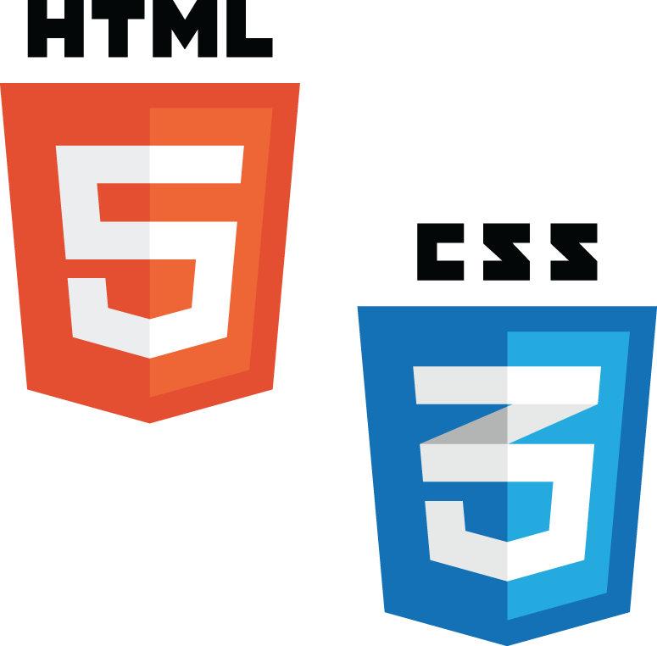




Technology used
HTML,bootstrap,python django framework,SQLite,javascript,CSS

Slide 27
Technology used
We have decided to use HTML, bootstrap and javascript as our front end language and for backend we will be using python. For connecting frontend and backend we are going to use python django framework and as a database we have SQLite

Slide 28
Model used
In C@RS we have used iterative model since we made it in multiple cycles of processes and so that in future we can use it to make enhanced version of original C@RS so that it can satisfy the growing needs of user .
Iterative process starts with a simple implementation of a subset of the software requirements and iteratively enhances the evolving versions until the full system is implemented. At each iteration, design modifications are made and new functional capabilities are added. The basic idea behind this method is to develop a system through repeated cycles (iterative) and in smaller portions at a time (incremental).

Slide 29
Django Framework
Django is a high-level Python Web framework that encourages rapid development and clean, pragmatic design. Built by experienced developers, it takes care of much of the hassle of Web development, so you can focus on writing your app without needing to reinvent the wheel. It’s free and open source.
A Web framework is a set of components that provide a standard way to develop websites fast and easily.

Slide 30
HTML
HTML stands for Hyper Text Markup Language. It is used to design web pages using a markup language. HTML is the combination of Hypertext and Markup language. Hypertext defines the link between the web pages. A markup language is used to define the text document within tag which defines the structure of web pages. This language is used to annotate (make notes for the computer) text so that a machine can understand it and manipulate text accordingly. Most markup languages (e.g. HTML) are human-readable.

Slide 31
Bootstrap
Bootstrap is a free front-end framework for faster and easier web development.
Bootstrap includes HTML and CSS based design templates for typography, forms, buttons, tables, navigation, modals, image carousels and many other, as well as optional JavaScript plugins. Bootstrap also gives you the ability to easily create responsive designs.
Responsive web design is about creating web sites which automatically adjust themselves to look good on all devices, from small phones to large desktops.
Bootstrap was developed by Mark Otto and Jacob Thornton at Twitter, and released as an open source product in August 2011 on GitHub.

Slide 32
SMTP
SMTP stands for Simple Mail Transfer Protocol.
SMTP is a set of communication guidelines that allow software to transmit an electronic mail over the internet is called Simple Mail Transfer Protocol.
The main purpose of SMTP is used to set up communication rules between servers. The servers have a way of identifying themselves and announcing what kind of communication they are trying to perform.

Slide 33
SQLite
SQLite is a C library that provides a lightweight disk-based database that doesn’t require a separate server process and allows accessing the database using a nonstandard variant of the SQL query language. Some applications can use SQLite for internal data storage. It’s also possible to prototype an application using SQLite and then port the code to a larger database such as PostgreSQL or Oracle.
The sqlite3 module was written by Gerhard Haring. It provides a SQL interface compliant with theDB-API 2.0 specification described by PEP 249.

Slide 34
Methodology

Slide 35
Methodology
For each of the products and services we add ,we applies a scoring methodology that is consistent within a product or service category. These scores are then weighed and combined to get a final overall rating and findin a good car as a service.

Slide 36
Methodology contd.
For a given product or service category, we include some or all of the following components in our scoring methodology:
Detailed Research - This could involve reading other reviews , combing through material provided by the different websites and different car websites.
Authentication - We provided the login features to the user in the website to ensure different facility to the user/custumer as well as user can also login as guest to use different features of the websites
Product Features - For each category we create a list of features that are evaluated and some features which are requirements for receiving best result . For example, a fuel type, body type, budget etc.

Slide 37
UML Diagrams

Slide 38
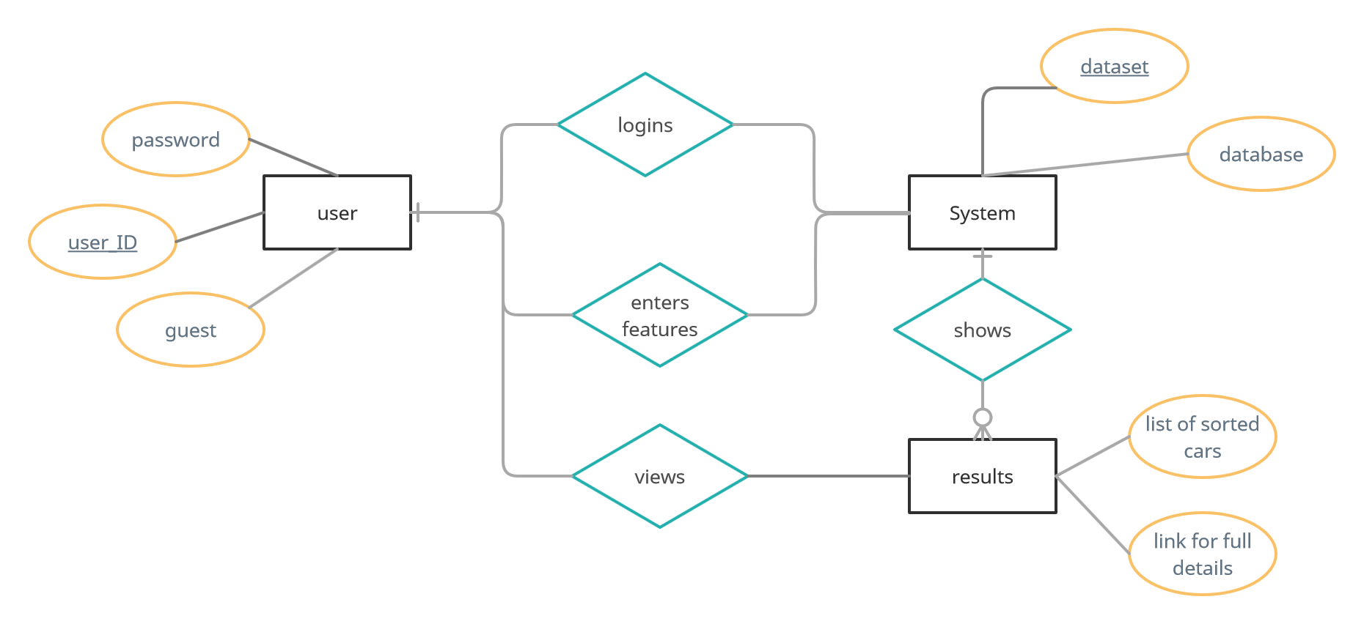
ER Diagram

Slide 39
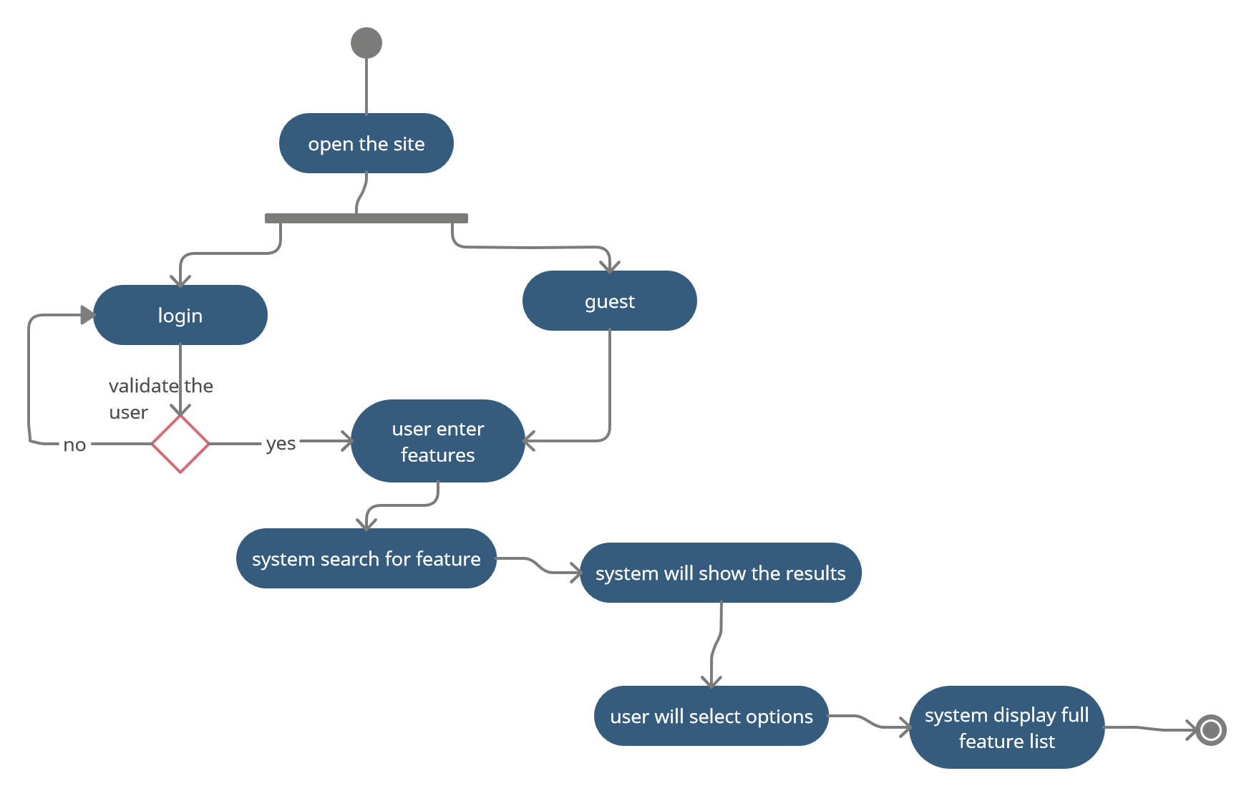
Activity Diagram

Slide 40
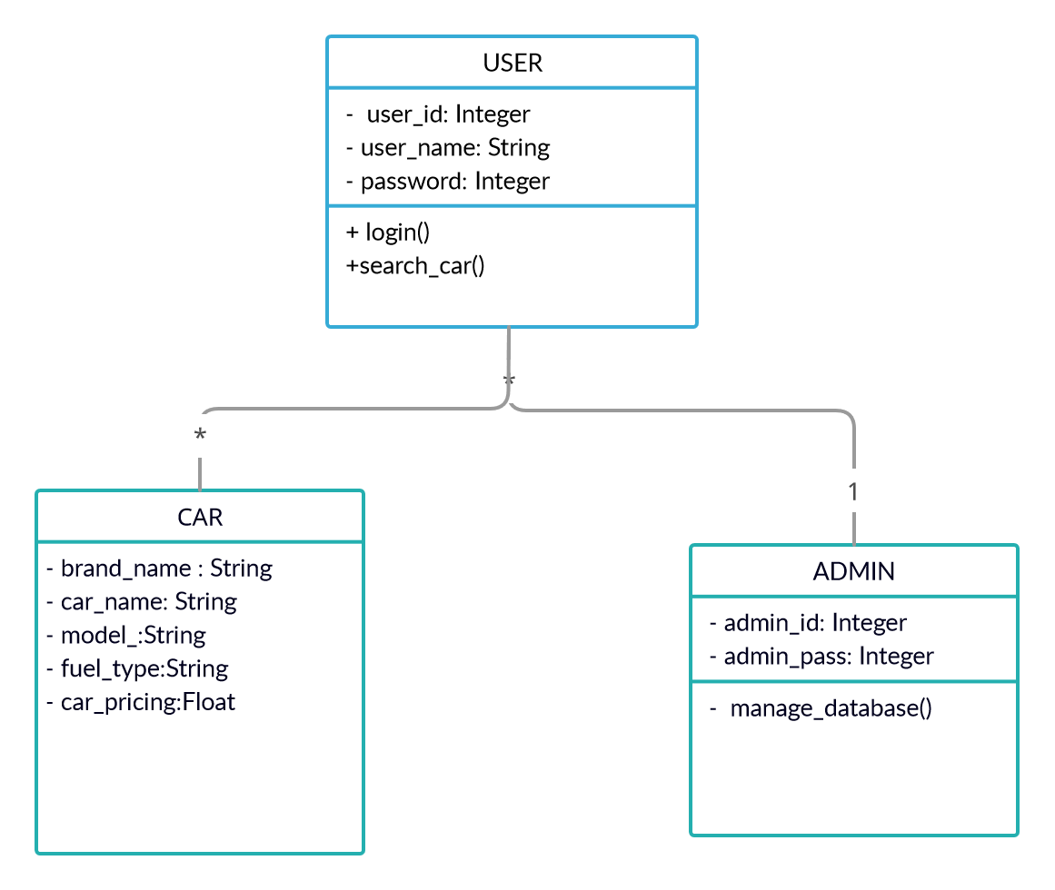
Class Diagram

Slide 41
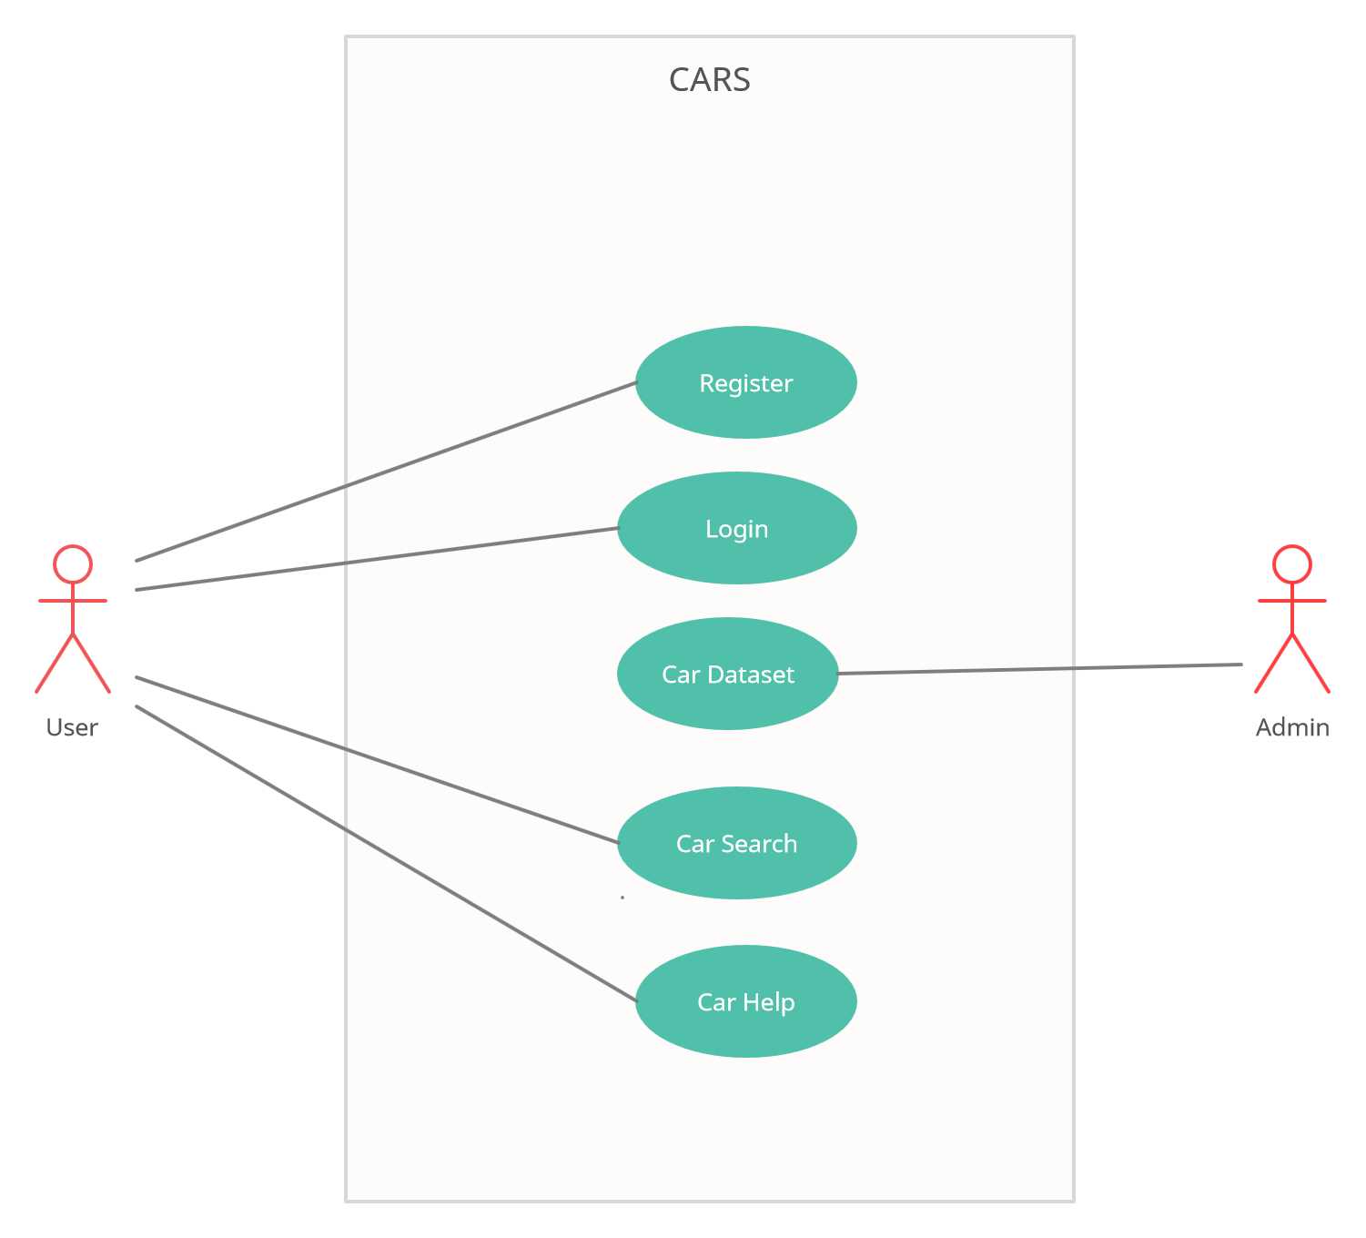
Use case Diagram

Slide 42
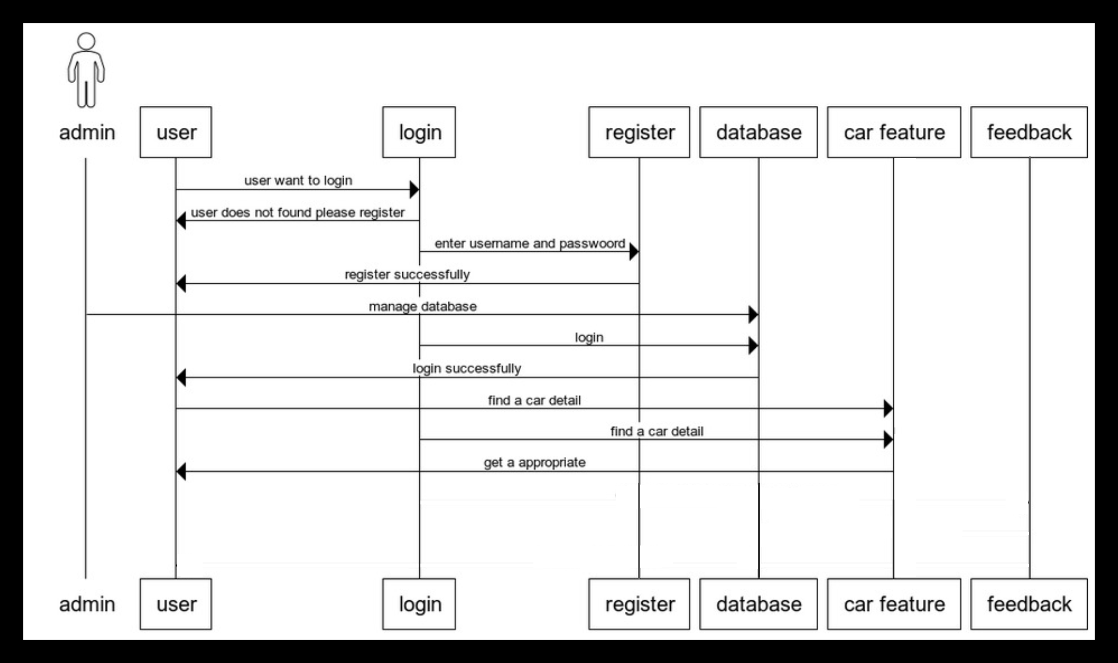
Sequence Diagram
SEQUENCE Diagram

Slide 43
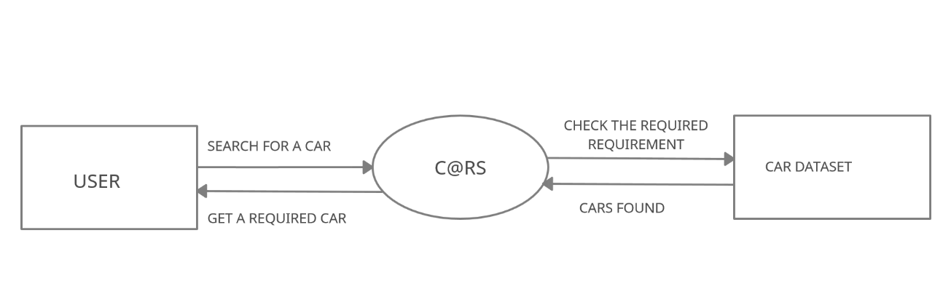
Data Flow Diagram level 0

Slide 44
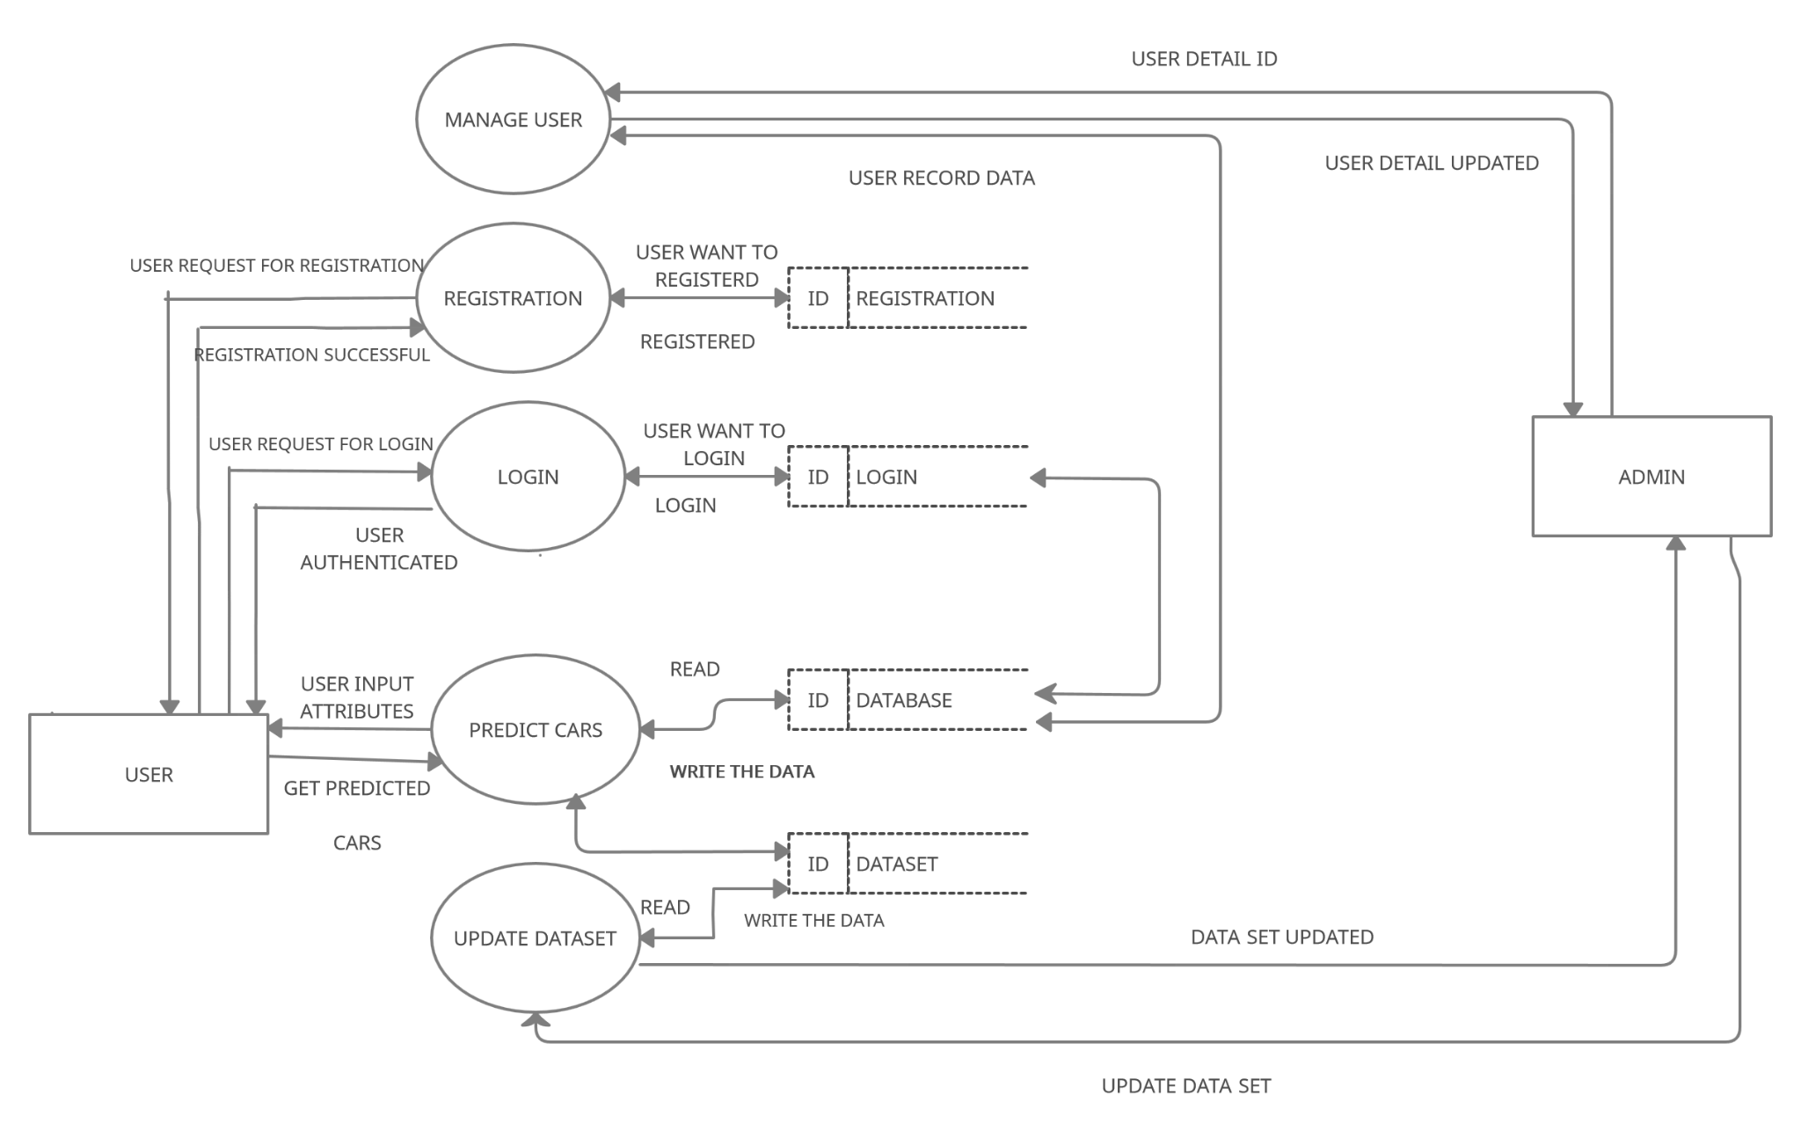
Data Flow Diagram level 01

Slide 45
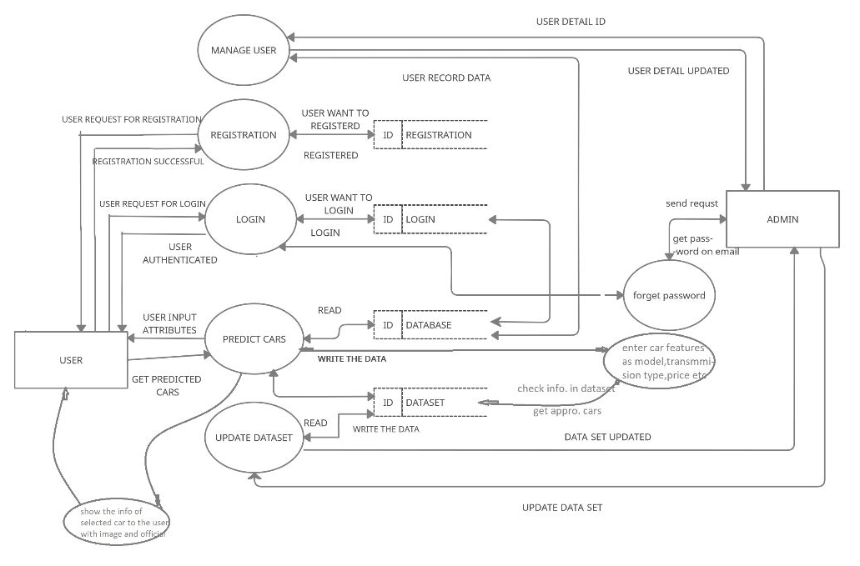
Data Flow Diagram level 02

Slide 46
Conclusion

Slide 47
CONCLUSION
The website was designed and developed in such a way that future modifications can be done easily.The following conclusions can be deduced from the development of the project.
Responsiveness of the entire system improves the accessiblity
It provides a friendly graphical user interface which proves to be better when compared to the existing system.
It gives appropriate access to the right information by providing official website links of car brands.

Slide 48
Contd.
It effectively find out car in your requirement.
The GUI is simple and minimal but complete in itself that which makes easy to navigate on website.
The System has adequate scope for modification in future if it is necessary.

Slide 49
Limitations

Slide 50
LIMITATION OF PROJECT
a. Currently system will show results of only non-premium brands.
b. Our System reduce the features of feedback for a while.

Slide 51
Future Enhancement

Slide 52
FUTURE ENHANCEMENT
C@RS is very useful in order to make Indian car buyers aware about the all available option in market. But it has some limitations like currently it works on non-premium brands only and best for Indian maximum family who afford medium range cars

Slide 53
References

Slide 54
References
REFERENCEBOOKS
SoftwareEngineering:APractitioner's ApproachbyRogerS. Pressma
https://docs.djangoproject.com/en/3.1
https://code.tutsplus.com/tutorials/sending-emails-in-python-with-smtp--cms-29975
https://getbootstrap.com/docs/4.1/getting-started/introduction/
https://docs.djangoproject.com/en/3.2/ref/templates/language/
https://docs.djangoproject.com/en/3.2/ref/databases/
https://docs.djangoproject.com/en/3.2/intro/tutorial02/
https://www.youtube.com/watch?v=0Ov1Yd1uCuA/
https://www.w3schools.com/bootstrap/bootstrap_images.asp/

Slide 55
C@RS Screenshot

Slide 56
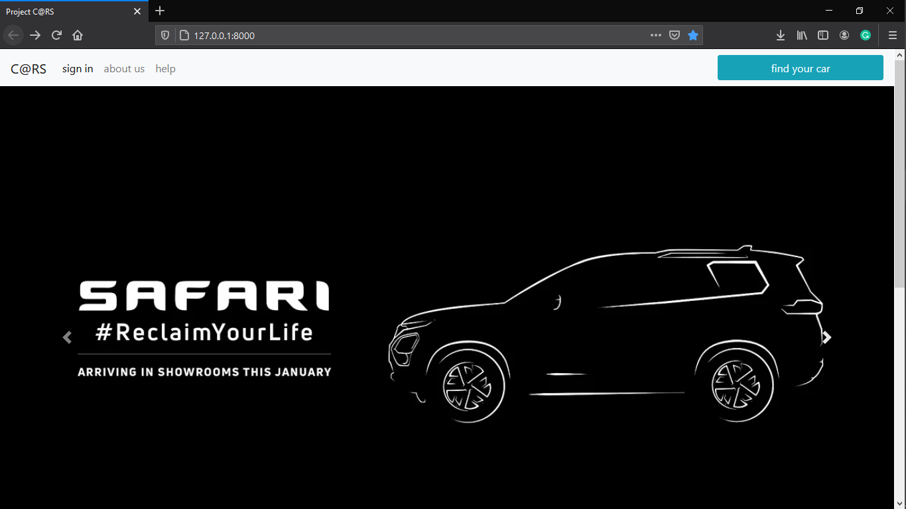

Slide 57
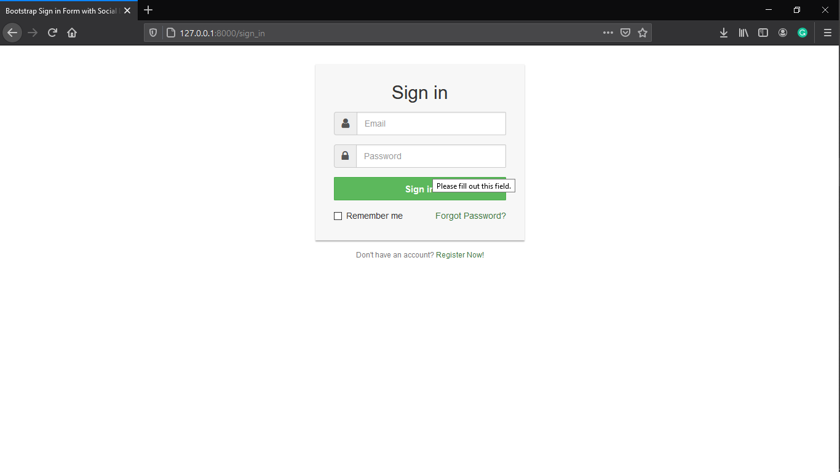
Forget
register

Slide 58
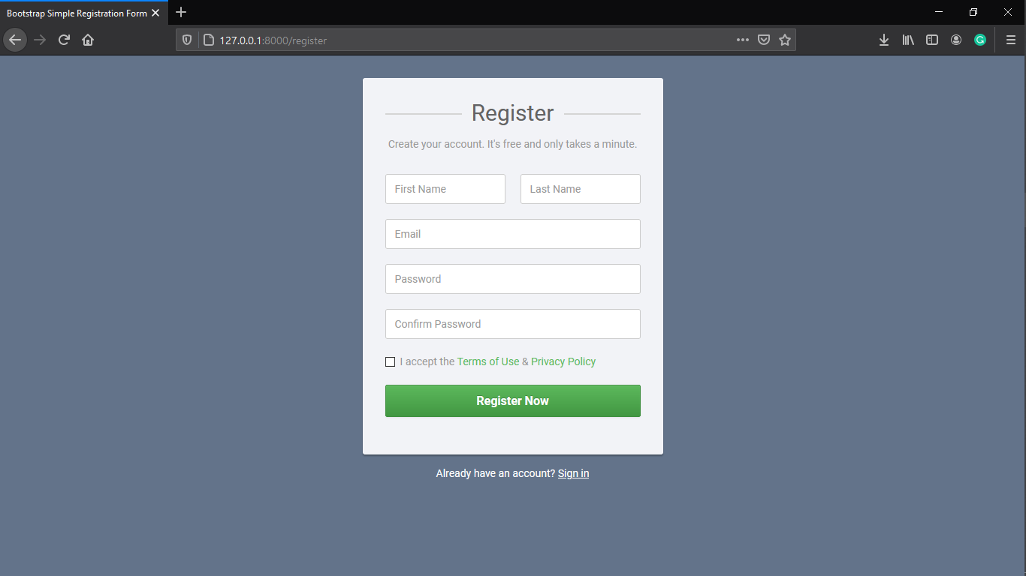
Sign in

Slide 59
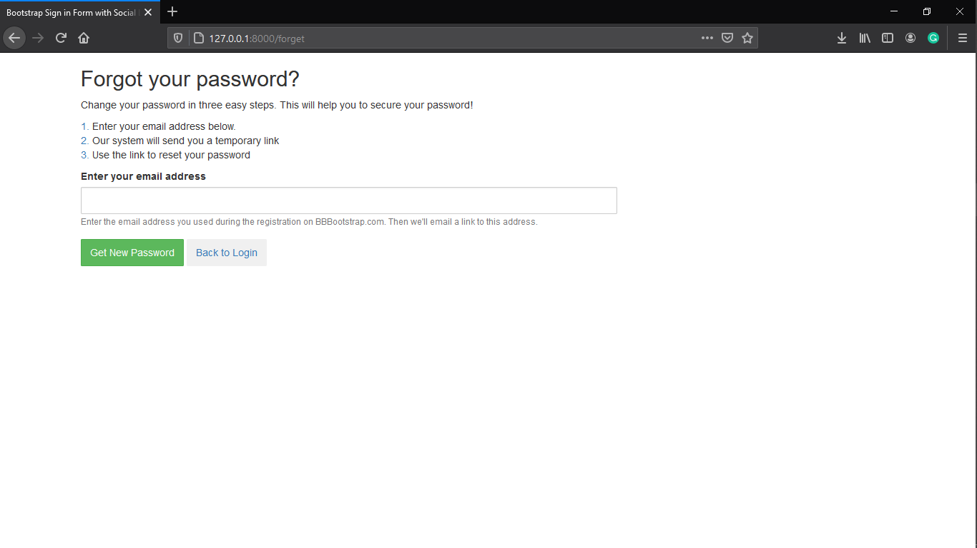

Slide 60
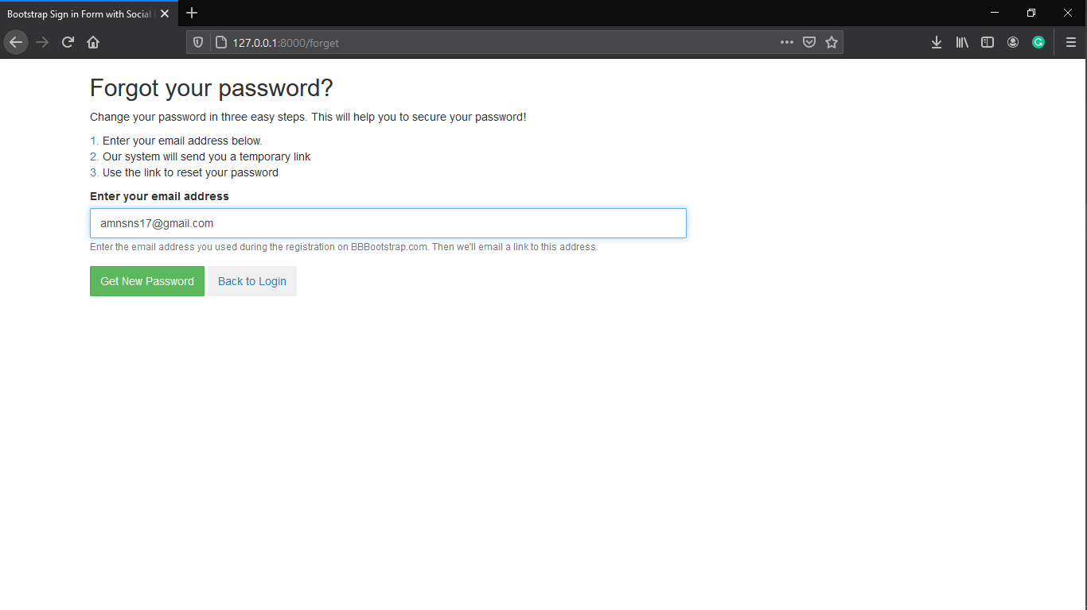
_
Get password

Slide 61
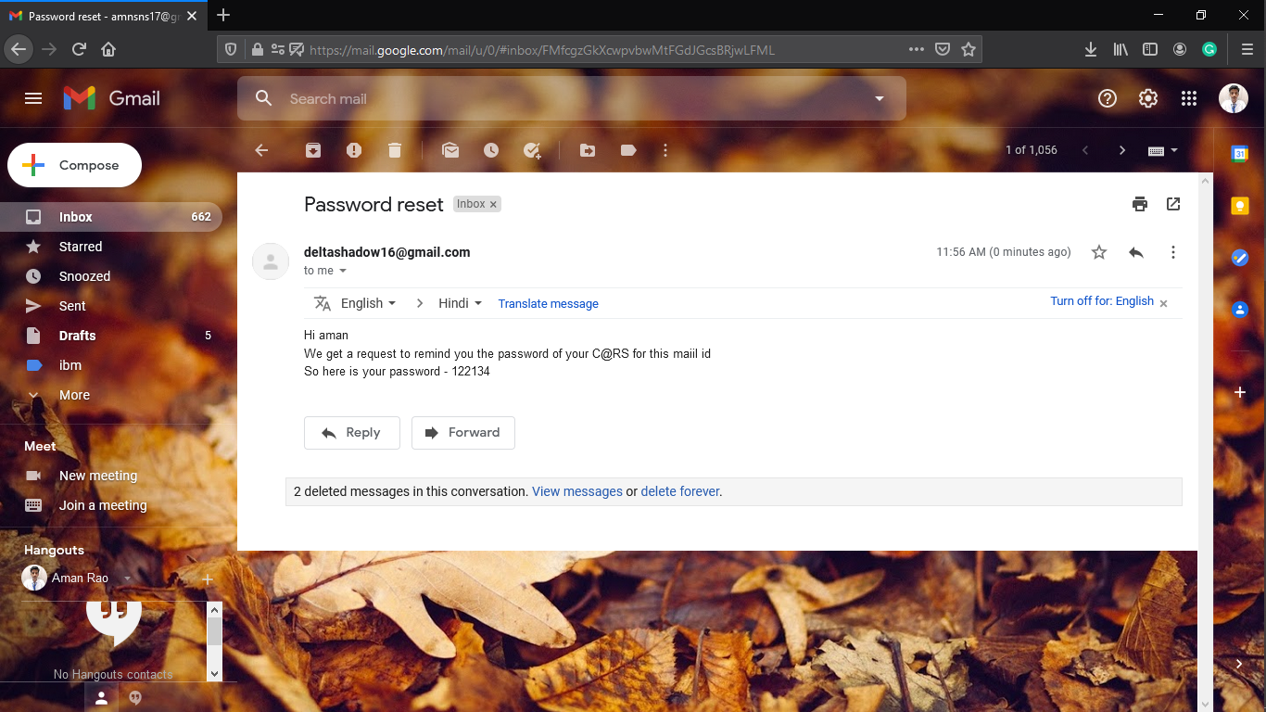

Slide 62
Find car

Slide 63
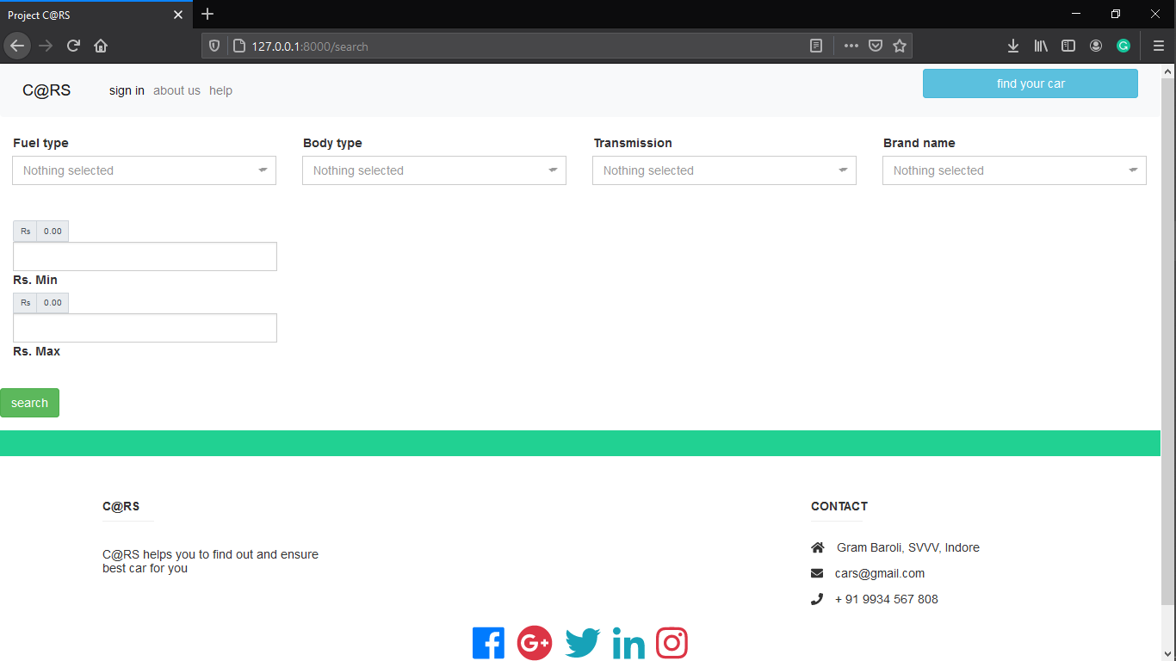
help

Slide 64
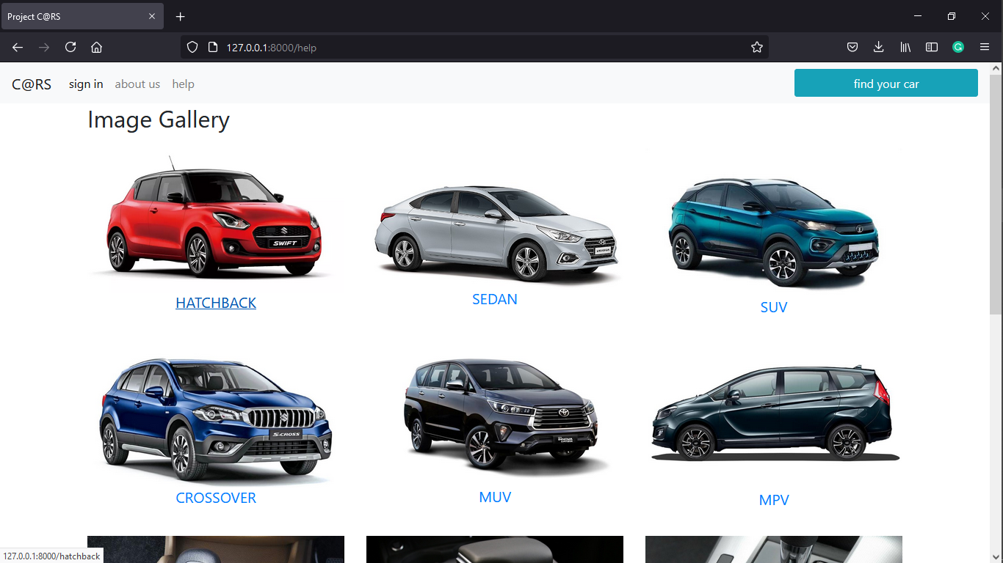
Find car

Slide 65
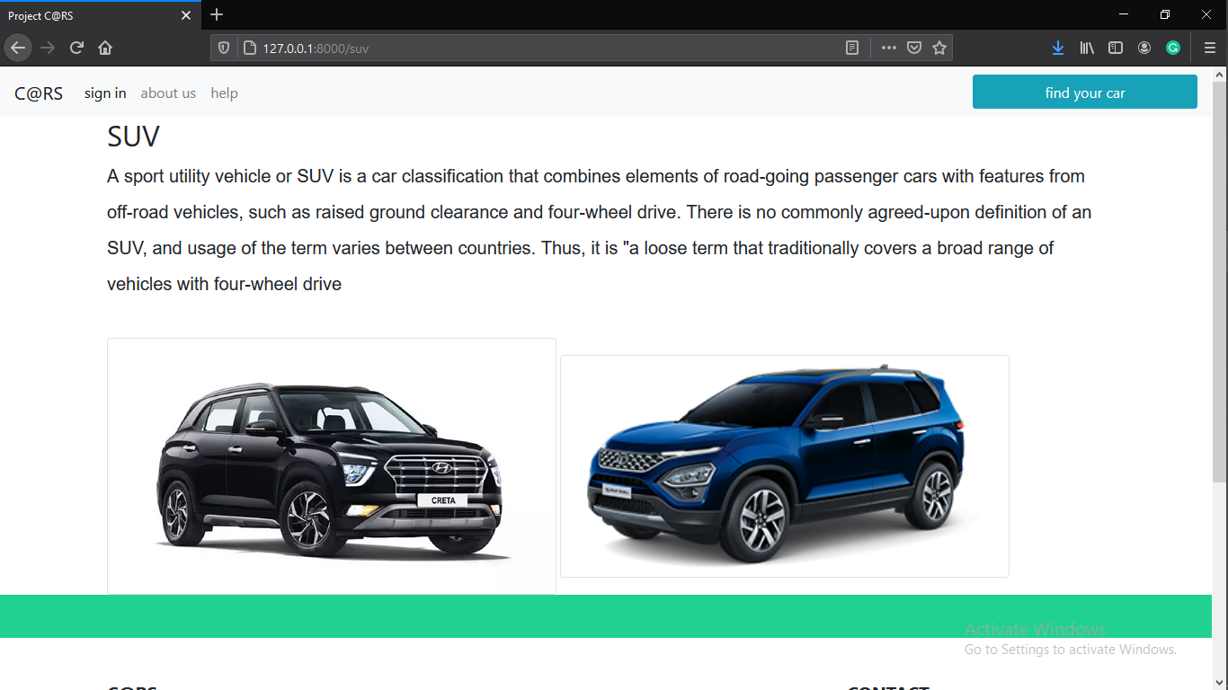
Find car

Slide 66
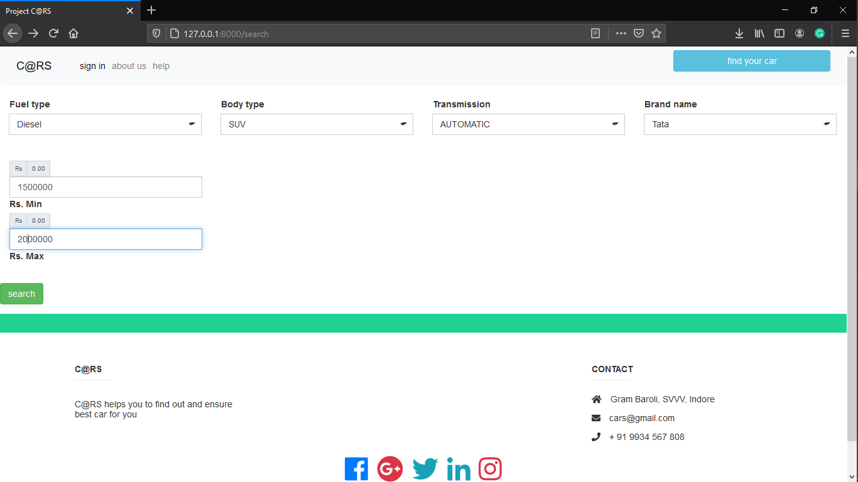
search

Slide 67
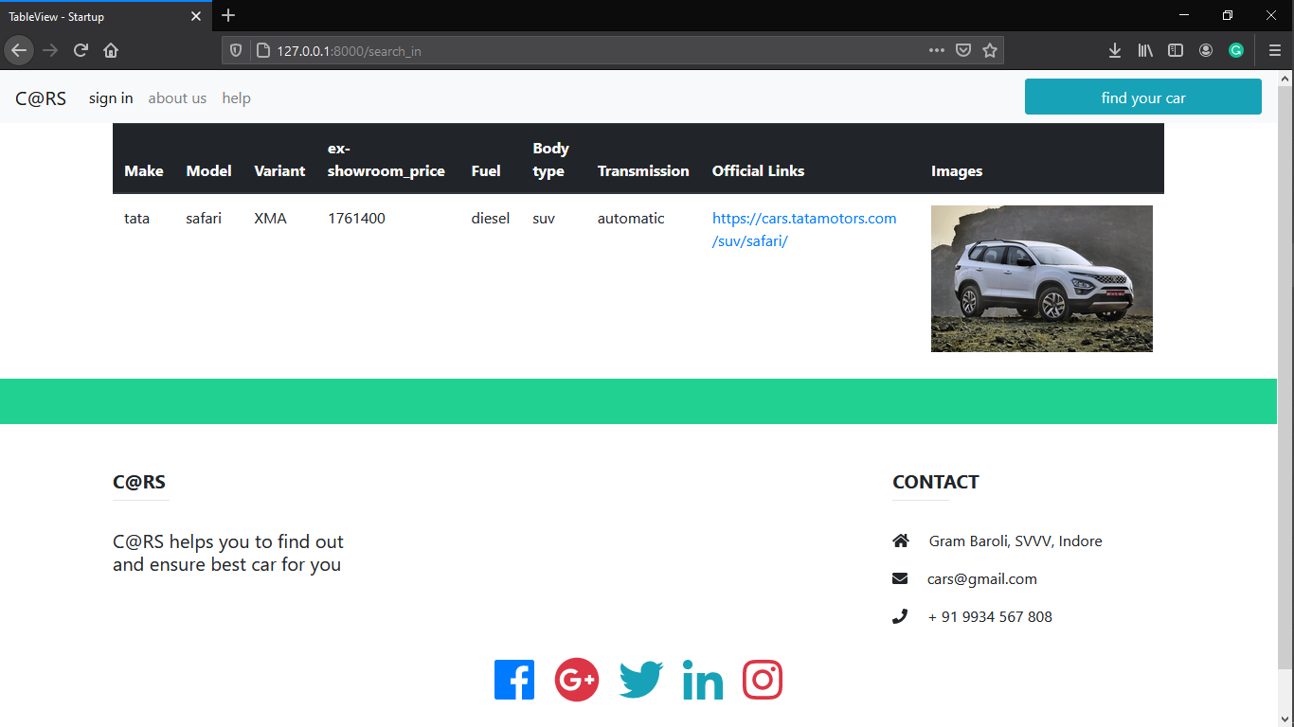
About us

Slide 68
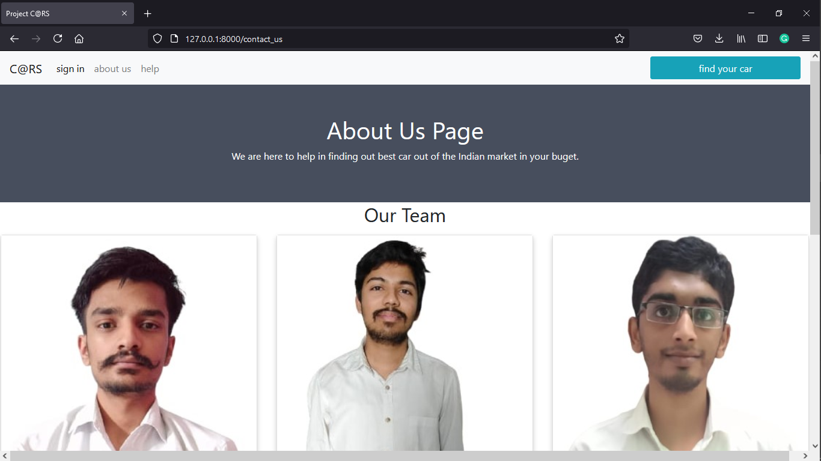

Slide 69
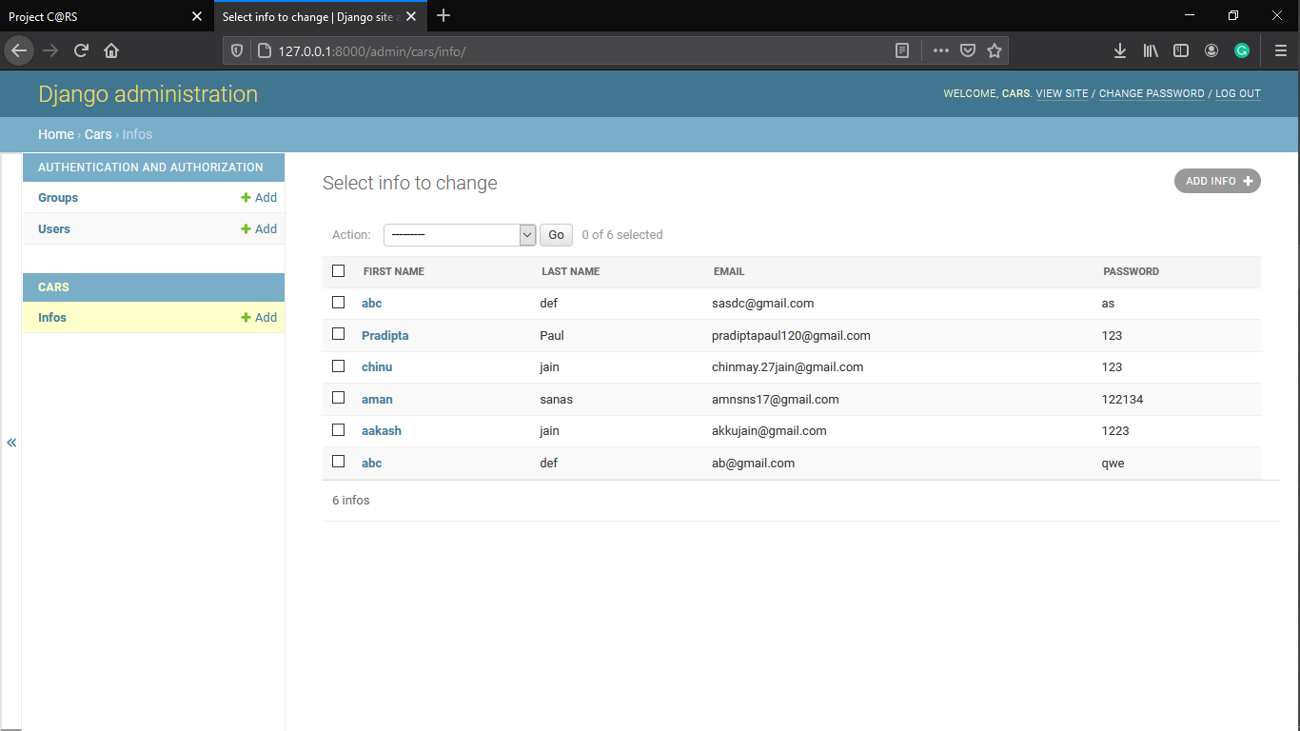

Slide 70
Thank you

